Slide 1
MIS 321
Adapter Pattern

Slide 2
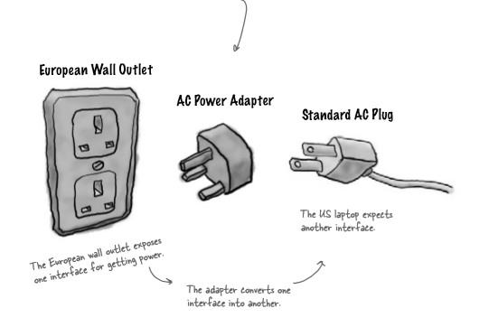
Adapters Are All Around Us
© Headfirst Design Patterns

Slide 3
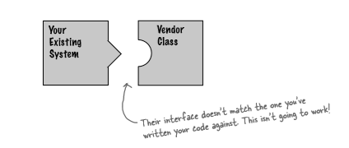
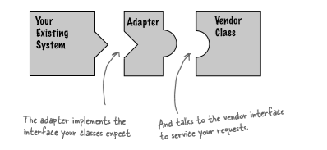
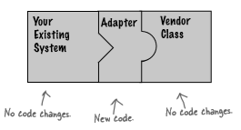
Adapter Pattern
Adapters are a part of modern life. We see them in the physical world (usb-c to usb-a) and also in software (the new PlayStation will run the old games).
Much like the usb adaptor example in the physical world, we have a common problem in software when one system supports interface-A and another application only provides interface-B.

Slide 4
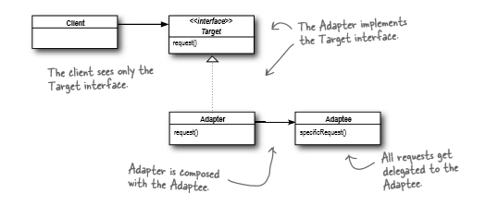
Adapter Pattern
The adapter pattern converts the interface of a class into another interface the clients expect. Adapter lets classes work together that couldn’t otherwise because of incompatible interfaces. (Structural Pattern)
Remember the decorator pattern? We “wrapped” objects to provide additional functionality? Similar concept, except the goal is to make compatible interfaces.

Slide 5
Adapter Pattern
Advantages
Helps achieve reusability and flexibility
Client class is not complicated by having to use a different interface and can use polymorphism to swap between different implementations of adapters
Disadvantages
All requests are forwarded, so there is increase in overhead
Sometimes many adaptations are required in a chain to reach the type that is required (HDMI → DVI → VGA)

Slide 6
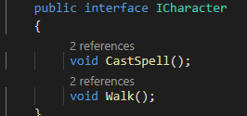
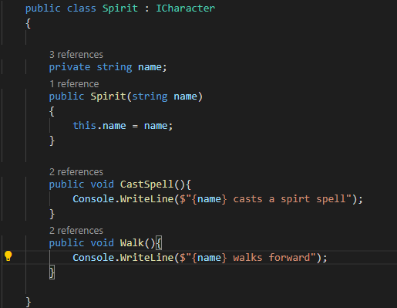
Let’s See It In Action!
ICharacter defines interface required
of all characters
Spirit implements that Character Interface

Slide 7
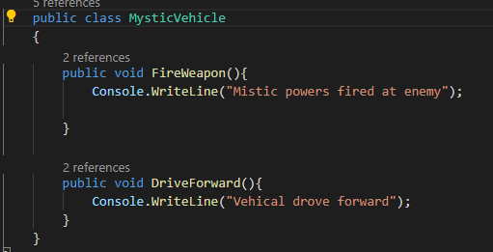
Let’s See It In Action!
Mystic Vehicles are not characters…… but what if we wanted to treat them like they were? FireWeapon is sort of like cast spell and drive is similar to walk?????

Slide 8
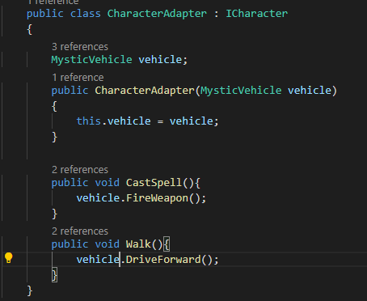
Let’s See It In Action!
We need an adaptor!

Slide 9
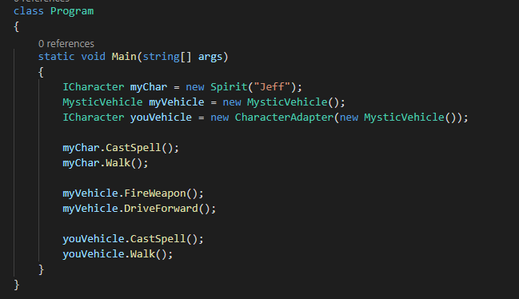
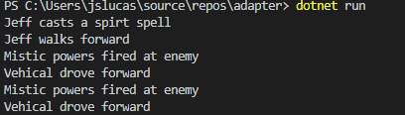
Let’s See It In Action!

